Slide 1


BANK ANALYTICS

Slide 2







OUR TEAM
Umang
Patel
Vinay Chaudhari
Shubham Gorade
Bhupesh Pandey
Sakshi Gorivale
Shubham Pawar
Nidhi Kumari

Slide 3





Project Timeline
Excel Module
30June-6July
Tableau Module
7-13 July
PowerBI Module
14-20 July
SQL Module
21-27 July

Slide 4

Short Intro Insights
Utilizing tools such as Power BI, Tableau, and Excel, we created attractive and simple-to-understand dashboards, enabling the client to gain a comprehensive overview of their key performance indicators (KPIs).
Our dashboards are designed to be user-friendly, allowing even non-technical users to easily understand and navigate them.
Each KPI is accompanied by detailed insights to provide the client with actionable and beneficial information, promoting positive growth when applied to their organization.

Slide 5
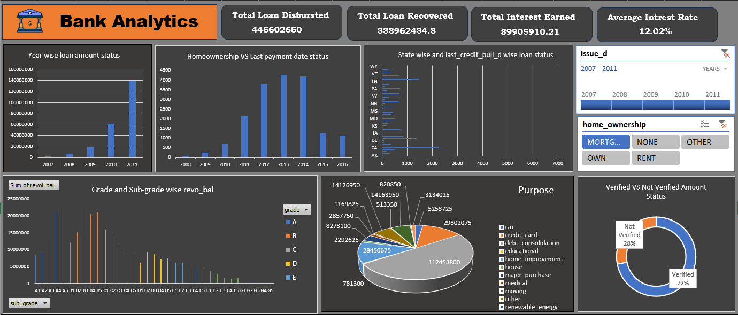
Excel

Slide 6
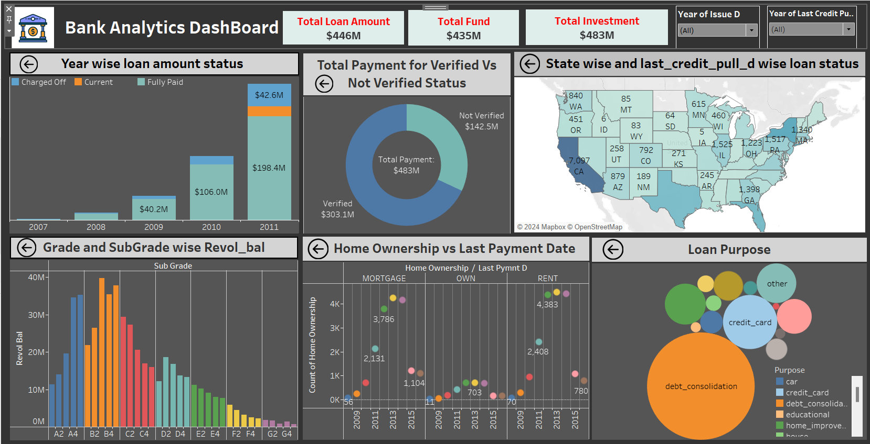
Tableau

Slide 7
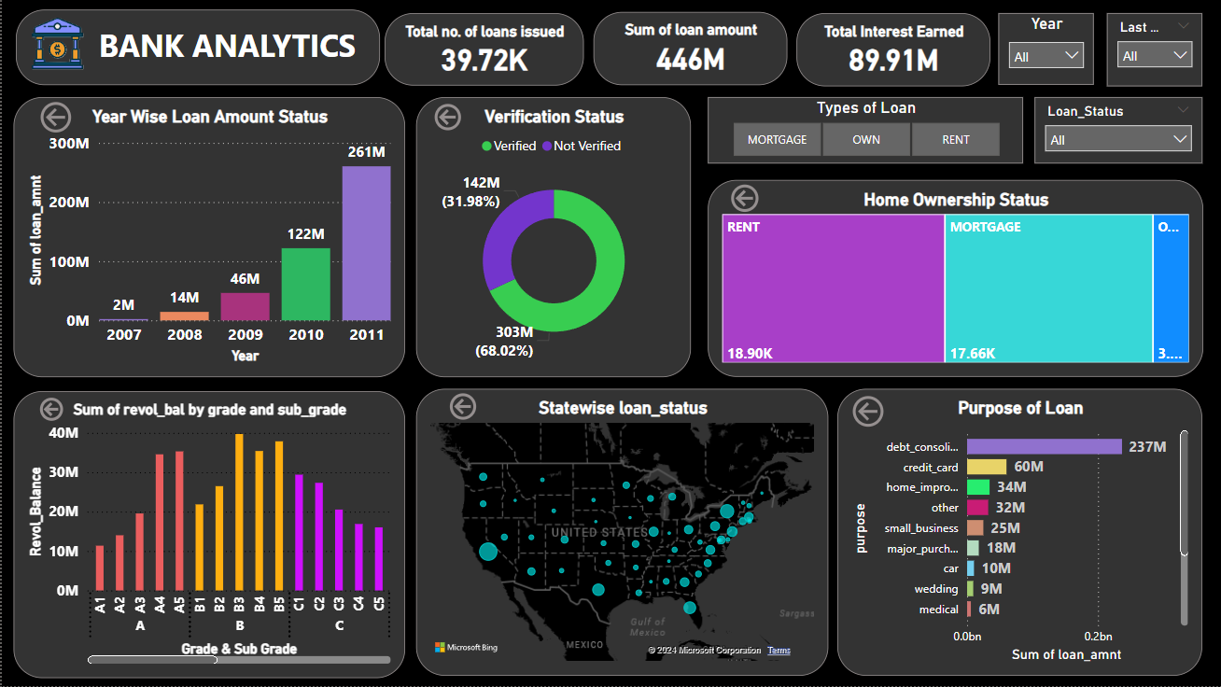
PowerBI

Slide 8
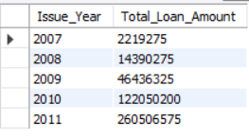

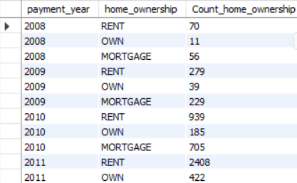
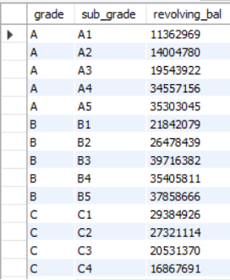
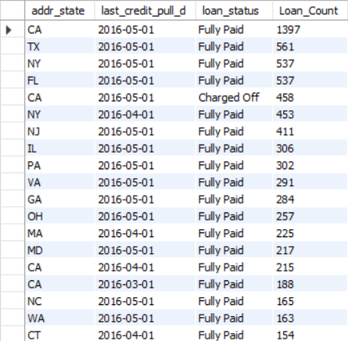
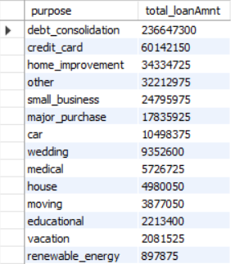
SQL
KPI 1
KPI 3
KPI 5
KPI 2
KPI 4
KPI 6

Slide 9

Overall Challeges Faced
Data Quality and Consistency - One of the primary challenges was dealing with inconsistent data. This included missing values, inconsistent formats, and blank entries that hindered our analysis.
Technical Skill Gaps - The project required proficiency in multiple tools and technologies, and some team members had varying levels of expertise in these areas.
Each module presented its own set of challenges, but by leveraging the strengths of our team and employing various strategies, we were able to overcome these obstacles and successfully complete our project.

Slide 10
Summary of Project
Year-wise Loan Amount Stats: Analyzed yearly trends in loan
issuance, identifying peak and low years.
Grade and Sub-grade wise Revolving Balance: Assessed the credit quality and risk associated with different loan grades.
Total Payment for Verified vs. Non-Verified Status: Compared repayment behavior between verified and non-verified loans, highlighting the importance of verification.
State-wise and Last Credit Pull Date wise Loan Status: Monitored loan performance and status across different regions and over time.
Home Ownership vs. Last Payment Date: Explored repayment patterns among homeowners and renters, providing insights into their financial behavior.
Purpose of Loan: Identified the most common loan purposes and their financial impact.

Slide 11

Overall Experience
01
02
03
04
Work on Time
Communication
Teamwork
Summarize

Slide 12


